Slide 1
Inheritance and Polymorphism
Java Interlude 7
Data Structures and Abstractions with Java, 4e
Frank Carrano
© 2015 Pearson Education, Inc., Upper Saddle River, NJ. All rights reserved.

Slide 2
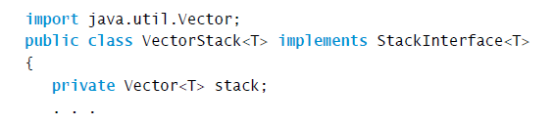

When to Use Inheritance
Given the class VectorStack
And given inheritance to derive VectorStack from Vector
© 2015 Pearson Education, Inc., Upper Saddle River, NJ. All rights reserved.

Slide 3
When to Use Inheritance
Resulting class has all methods of Vector in addition to those in StackInterface
However, these Vector methods enable a client to add or remove entries anywhere within the stack,
  Thus violating the premise of the ADT stack.
  Instead of a stack, we would have an enhanced vector
Since no “is-a” relationship, should not use inheritance this way
© 2015 Pearson Education, Inc., Upper Saddle River, NJ. All rights reserved.

Slide 4
When to Use Inheritance
Security issues
Limit your use of inheritance
Realize that a superclass can affect the behavior of a subclass
© 2015 Pearson Education, Inc., Upper Saddle River, NJ. All rights reserved.

Slide 5
Protected Access
You can use the access modifier protected for methods and data fields.
Method or data field modified by protected can be accessed by name only within:
  Its own class definition C
  Any class derived from C
  Any class within the same package as C
© 2015 Pearson Education, Inc., Upper Saddle River, NJ. All rights reserved.

Slide 6
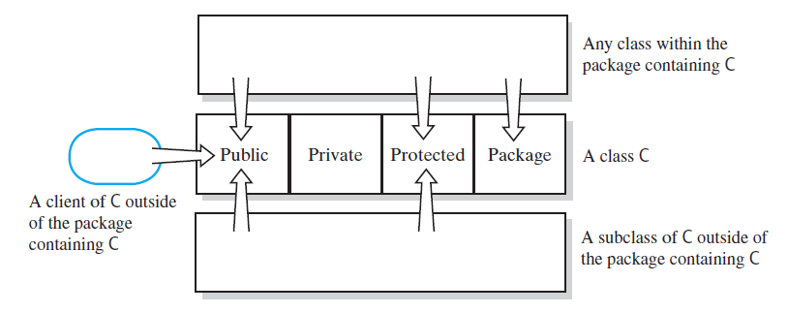
Protected Access
FIGURE C-4 Public, private, protected, and package access of the data fields and methods of class C
© 2015 Pearson Education, Inc., Upper Saddle River, NJ. All rights reserved.

Slide 7
Abstract Classes and Methods
An abstract class will be the superclass of another class
Thus, an abstract class is sometimes called an abstract superclass.
Declare abstract method by including reserved word abstract in header
© 2015 Pearson Education, Inc., Upper Saddle River, NJ. All rights reserved.

Slide 8
Abstract Classes and Methods
Abstract method cannot be private, static, or final.
Class with at least one abstract method must be declared as an abstract class
  Abstract methods can appear only within an abstract class.
Constructors cannot be abstract
© 2015 Pearson Education, Inc., Upper Saddle River, NJ. All rights reserved.

Slide 9
Polymorphism
Polymorphism allows same program instruction to mean different things in different contexts
  Context (which version of a method) determined at run time
Java uses an object’s dynamic type, not its name, to see which method to invoke
© 2015 Pearson Education, Inc., Upper Saddle River, NJ. All rights reserved.

Slide 10
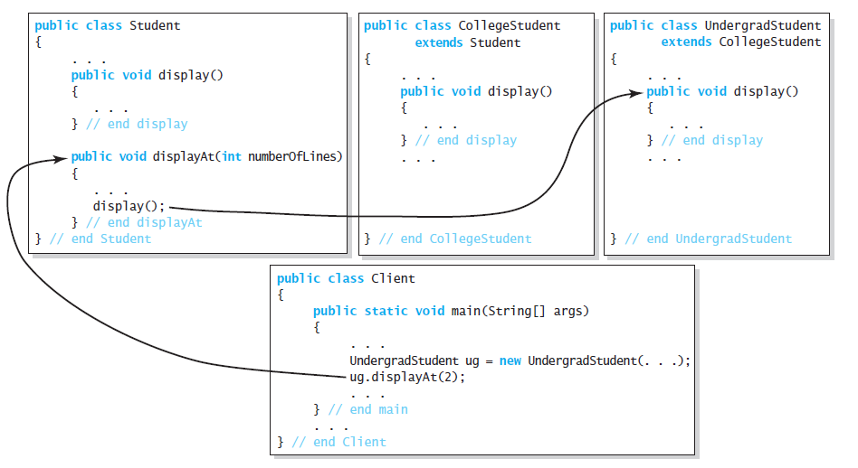
Polymorphism
FIGURE JI7-6 The method displayAt calls
the correct version of display
© 2015 Pearson Education, Inc., Upper Saddle River, NJ. All rights reserved.

Slide 11
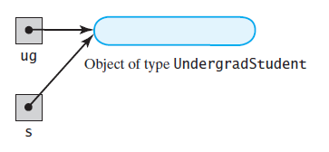
Polymorphism
FIGURE JI7-7 The variable s is another name for an object
© 2015 Pearson Education, Inc., Upper Saddle River, NJ. All rights reserved.

Slide 12
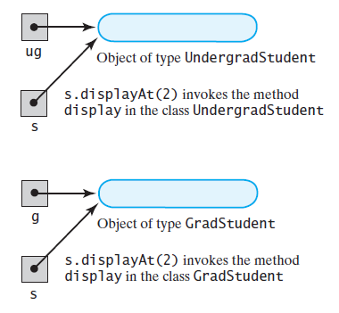
Polymorphism
FIGURE JI7-8 An object, not its name, determines its behavior
© 2015 Pearson Education, Inc., Upper Saddle River, NJ. All rights reserved.

Slide 13
End
Java Interlude 7
© 2015 Pearson Education, Inc., Upper Saddle River, NJ. All rights reserved.

